Slide 2
Concept of VLAN (Virtual LAN) and Benefits
Virtual LAN is a logical segmentation of local area network (LAN) into different set of broadcasting domains. Because the segmentation is not physical it is called virtual. Different Users in same location or in different locations can use the same LAN.

Slide 3
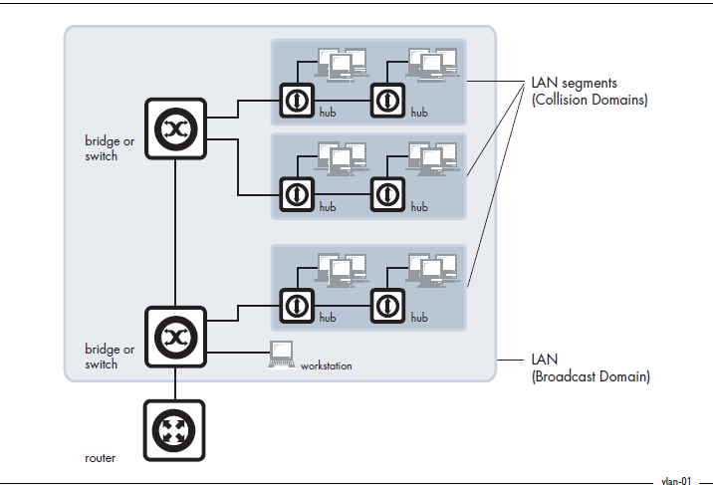

Slide 4
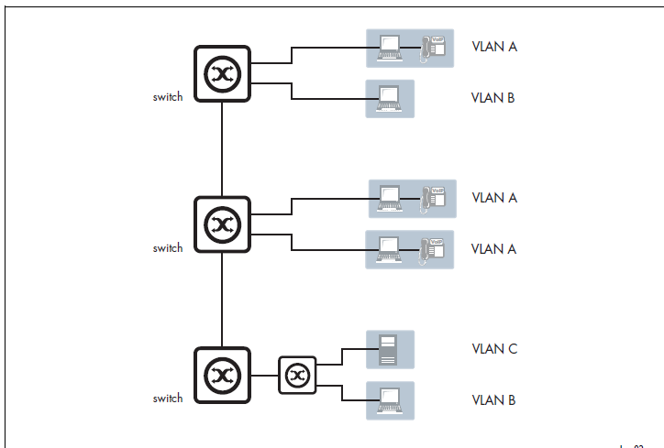

Slide 5
Advantages
High Performance:
Generally, switches and routers need more processing time for incoming traffic because as the traffic passes through the routers, latency increases and the network performance decreases. If VLAN is used, then there is no need of extra routers since VLAN creates broadcasting domains.

Slide 6
Virtual workgroups:
In current scenario, most of the communication within the organization takes place in small workgroups (e.g. development team , marketing team , accounting team) to manage broadcast and multi-cast functionality within the workgroups, VLAN can be used to enable communication.

Slide 7
cost effective
The cost of routers can be reduced when VLANs are used like broadcasting domains

Slide 8
Easy administration
Traditional LAN has many access management issues, including LAN cabling, new station setup and addressing, and configuration of hubs and routers. While using vLAN this access management effort can be reduced because user movement within vLAN requires no reconfiguration of routers and hubs.

Slide 9
Enhanced security
VLAN is also used to set firewalls, restrict access permission for outside access, adding an extra layer of security for intrusion detection and controlling broadcasting domain.

Slide 11
Concept of SAN (Virtual SAN) and Benefits
When a Logical partition is created within a physical storage area network (SAN), it is called virtual storage area network (VSAN). Virtualization technology enables division and allocation of entire storage area network into more logical SANs

Slide 12
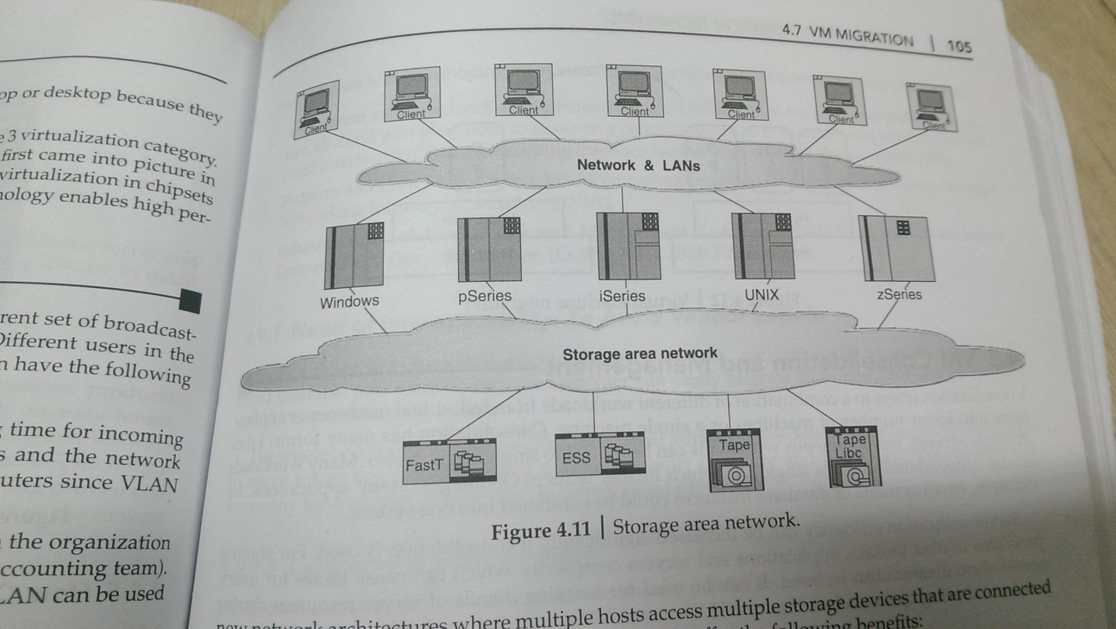

Slide 13
Benefits of SAN
Enhanced application availability
Higher application performance
Centralized and consolidated storage
Data transfer and vaulting to remote sites
Simplified centralized management

Slide 14
VM Migration
It refers to the movement or transfer between different physical machines without any discontinuity

Slide 15
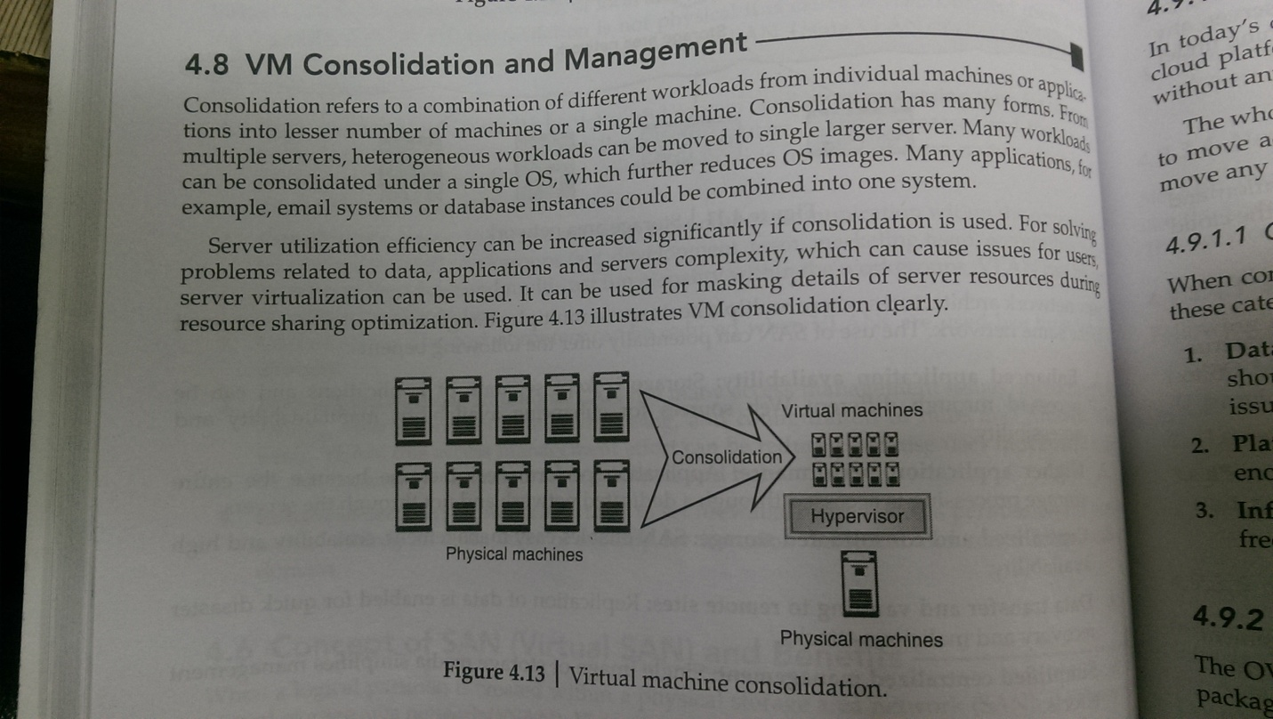
VM consolidation and management

Slide 16
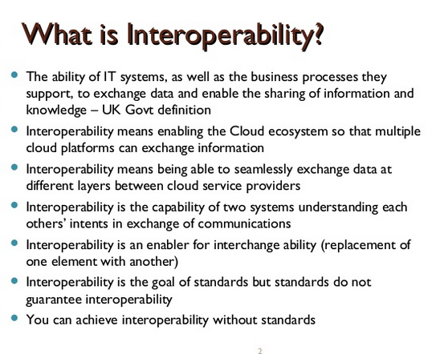

Slide 17
Cloud Interoperability standards
There is a strong need for the development of integrated interoperability authentication among all provider.
Several organizations such as the Cloud Computing Interoperability Forum (CCIF) have been working on solutions to address cloud interoperability challenges. The Cloud standards Customer Council (CSCC) provides the opportunity to convert and synchronize client needs and specified requirement into standards of development cloud firms and also for cloud users. It provides standard research materials and documents

Slide 18
Categories of Interoperability
When consumer wish to migrate from one cloud Provider to another. interoperability falls into these categories:
1. Data and application portability: It means by running applications and data, consumers should be able to migrate easily from one cloud provides to another without any lock-in issue.
2 Platform portability: It means application development environment or IDE should be capable enough to run over any type of cloud infrastructure.
3. Infrastructure portability: it means virtual server or machine images should have the freedom of portability They should he able to migrate from one cloud provider to another.

Slide 19
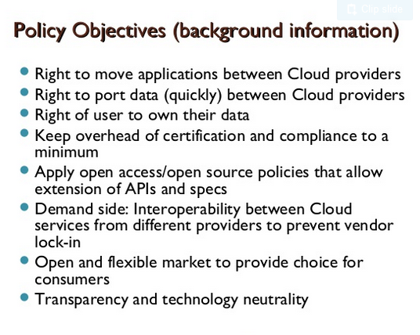

Slide 20
Open standards for solving cloud interoperability challanges
Application solution: UCI- uniform cloud interface is developing interface for the unification of various cloud APIs.
Platform solution: CCIF, open cloud computing interface (OCCI) working group.
Infrastructure solution: distributed management task force(DMTF), OVF etc.

Slide 21
Open virtualization format
Characterstics:
1)Open standard
2)Portable VM packaging
3)Optimized for distribution
4)Multiple VM support
5)Vendor and plateform indepedent

